Slide 1
CT050-3-3-PRMGT - Project Management
Topic 01: An Introduction to Project, Program, and Portfolio Management

Slide 2
TOPIC LEARNING OUTCOMES
At the end of this topic, you should be able to:
1. Understand the growing need for better project, program, and portfolio management
2.Explain what a project is, provide examples of projects, list various attributes of
projects, and describe project constraints
3. Describe project management and discuss key elements of the project management framework,
including project stakeholders, the project management knowledge areas, common tools and
techniques, project success factors, and project benefits measurement
4. Discuss the relationship between project, program, and portfolio management and their contribution
to enterprise success
5. Describe the project management profession, including the role of project managers and suggested skills for project management careers.

Slide 3
Key Terms You Must Be Able To Use
If you have mastered this topic, you should be able to use the following terms correctly in your assignments and exams:
Project
Program
Portfolio
Stakeholders
Knowledge Areas
Process Groups

Slide 4
Recap From Last Lesson
Nil

Slide 5
Introduction
Many organizations today have a new or renewed interest in project management (PM). Why?
Demand for projects continues to increase, with GDP contributions from project-oriented industries forecasted to be US$20.2 trillion by 2017. Employers will need 87.7 million individuals working in project management-oriented roles by 2027.”
The job market is good for college graduates who demonstrate the most important attribute employers want: the ability to work as part of a team.
Organizations waste $97 million for every $1 billion spent on projects.

Slide 6
What Went Wrong?
A 1995 Standish Group study (The CHAOS Report) found that only 16.2 percent of information technology (IT) application development projects were successful in meeting scope, time, and cost goals. Over 31 percent of the projects were canceled before completion, costing over $81 billion in the U.S. alone
A PriceWaterhouseCoopers study of 200 companies from 30 different countries found that over half of all projects fail

Slide 7
Advantages of Using Formal Project Management
Better control of financial, physical, and human resources
Improved customer relations
Shorter development times
Lower costs
Higher quality and increased reliability
Higher profit margins
Improved productivity
Better internal coordination
Higher worker morale

Slide 8
What Is a Project?
A project is “a temporary endeavor undertaken to create a unique product, service, or result”*
Operations is work done to sustain the business
Projects end when their objectives have been reached, or the project has been terminated
*Project Management Institute, Inc., A Guide to the Project Management Body of Knowledge (PMBOK® Guide – Sixth Edition) (2017).

Slide 9
Examples of Projects
A young couple hires a firm to design and build them a new house
A medical technology firm develops a device that connects to smart phones
A group of musicians starts a company to help children develop their musical talents
A pharmaceutical company launches a new drug
A television network develops a system to allow viewers to vote for contestants and provide other feedback on programs
The automobile industry develops standards for electric cars
A government group develops a program to track child immunizations

Slide 10
Project Attributes
A project:
Has a unique purpose
Is Temporary
Drives change and enables value creation
Is developed using progressive elaboration or in an iterative fashion
Requires resources, often from various areas
Should have a primary customer or sponsor
The project sponsor usually provides the direction and funding for the project
Involves uncertainty

Slide 11
Project Constraints
Every project is constrained in different ways. Some project managers focus on the triple constraint (meeting scope, time, and cost goals)
Scope: What work will be done as part of the project? What unique product, service, or result does the customer or sponsor expect from the project?
Time: How long should it take to complete the project? What is the timeline?
Cost: What should it cost to complete the project? What is the project’s budget? What resources are needed?
Other constraints include quality, risk, and resources

Slide 12
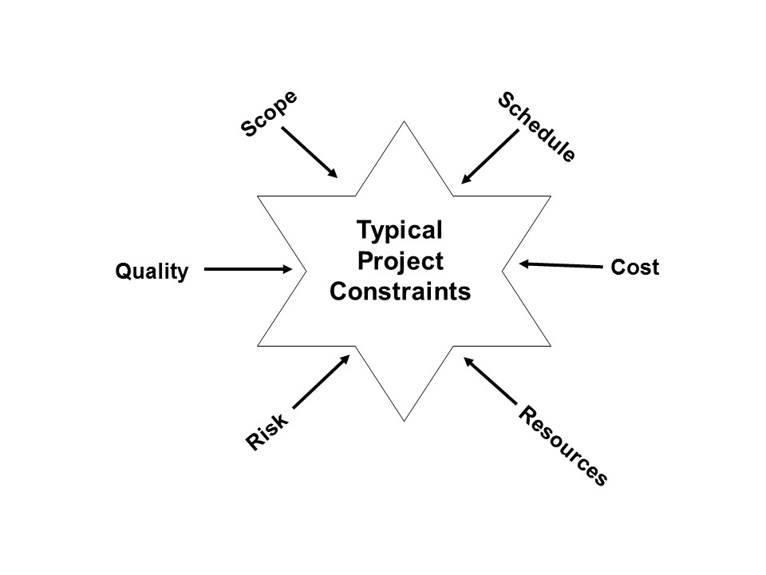
Figure 1-2. Typical Project Constraints

Slide 13
What is Project Management?
Project management is “the application of knowledge, skills, tools and techniques to project activities to meet project requirements.”*
*Project Management Institute, Inc., A Guide to the Project Management Body of Knowledge (PMBOK® Guide, Sixh Edition) (2017).

Slide 14
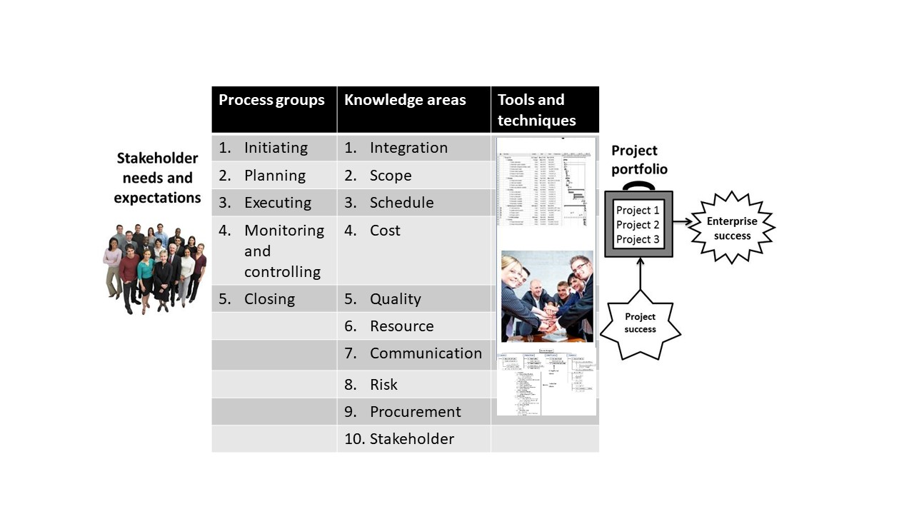
Figure 1-3. Project Management Framework

Slide 15
Project Stakeholders
Stakeholders are the people involved in or affected by project activities
Stakeholders include:
The project sponsor
The project manager
The project team
Support staff
Customers
Suppliers
Opponents to the project

Slide 16
Project Management Knowledge Areas
Project integration management is an overarching function that coordinates the work of all other knowledge areas. It affects and is affected by all of the other knowledge areas.
Project scope management involves working with all appropriate stakeholders to define, gain written agreement for, and manage all the work required to complete the project successfully.
Project time management includes estimating how long it will take to complete the work, developing an acceptable project schedule given the cost-effective use of available resources, and ensuring the timely completion of the project.
Project cost management consists of preparing and managing the budget for the project.
Project quality management ensures that the project will satisfy the stated or implied needs for which it was undertaken.

Slide 17
Project Management Knowledge Areas (continued)
Project resource management is concerned with making effective use of the people and physical resources needed for the project.
Project communications management involves generating, collecting, disseminating, and storing project information.
Project risk management includes identifying, analyzing, and responding to risks related to the project.
Project procurement management involves acquiring or procuring goods and services for a project from outside the performing organization.
Project stakeholder management focuses on identifying project stakeholders, understanding their needs and expectations, and engaging them appropriately throughout the project.

Slide 18
Project Management Tools and Techniques
Project management tools and techniques assist project managers and their teams in various aspects of project management.
Note that a tool or technique is more than just a software package.
Specific tools and techniques include:
Project charters, scope statements, and WBS (scope)
Gantt charts, network diagrams, critical path analyses (time)
Net present value, cost estimates, and earned value management (cost)
See Figure 1-4 for more examples

Slide 19
Figure 1-4. Common Project Management Tools and Techniques by Knowledge Areas
Knowledge Area/Category | Tools and Techniques
Integration management | Project selection methods, project management methodologies, project charters, project management plans, project management software, change requests, change control boards, project review meetings, lessons-learned reports
Scope management | Scope statements, work breakdown structures, mind maps, statements of work, requirements analyses, scope management plans, scope verification techniques, and scope change controls
Schedule management | Gantt charts, project network diagrams, critical-path analyses, crashing, fast tracking, schedule performance measurements
Cost management | Net present value, return on investment, payback analyses, earned value management, project portfolio management, cost estimates, cost management plans, cost baselines
Quality management | Quality metrics, checklists, quality control charts, Pareto diagrams, fishbone diagrams, maturity models, statistical methods

Slide 20
Figure 1-4. Common Project Management Tools and Techniques by Knowledge Areas (continued)
Knowledge Area/Category | Tools and Techniques
Resource management | Motivation techniques, empathic listening, responsibility assignment matrices, project organizational charts, resource histograms, team building exercises
Communications management | Communications management plans, kickoff meetings, conflict management, communications media selection, status and progress reports, virtual communications, templates, project websites
Risk management | Risk management plans, risk registers, probability/impact matrices, risk rankings
Procurement management | Make-or-buy analyses, contracts, requests for proposals or quotes, source selections, supplier evaluation matrices
Stakeholder management | Stakeholder registers, stakeholder analyses, issue logs, interpersonal skills, reporting systems

Slide 21
Tools and Techniques by Purpose
The PMBOK® Guide – Sixth Edition now lists tools and techniques based on their purpose, as follows:
Data gathering
Data analysis
Data representation
Decision making
Communication
Interpersonal and team skills
Ungrouped

Slide 22
Project Success
There are different ways to define project success:
The project met scope, time, and cost goals.
The project satisfied the customer/sponsor.
The project produced the desired results.

Slide 23
Programs and Megaprojects
A program is “a group of related projects, subsidiary programs, and program activities managed in a coordinated manner to obtain benefits not available from managing them individually.”
A megaproject is a very large project that typically costs over US $1 billion, affects over one million people, and lasts several years.
*Project Management Institute, Inc., A Guide to the Project Management Body of Knowledge (PMBOK® Guide – Sixth Edition) (2017).

Slide 24
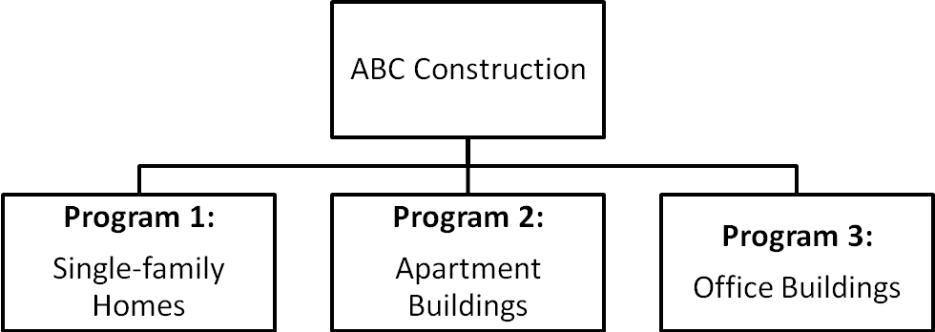
Figure 1-5. Example Programs

Slide 25
Project Portfolio Management
A portfolio is defined as “projects, programs, subsidiary portfolios, and operations managed as a group to achieve strategic objective.”*
Many organizations support an emerging business strategy of project portfolio management by continuously selecting and managing the optimum set of projects and programs to deliver maximum business value.
Organizational project management is a “framework in which portfolio, program, and project management are integrated with organizational enablers in order to achieve strategic objectives.”
*Project Management Institute, Inc., A Guide to the Project Management Body of Knowledge (PMBOK® Guide – Sixth Edition) (2017).

Slide 26
Project and Program Management Compared to Project Portfolio Management
Project and program management address questions like:
Are we carrying out projects well?
Are projects on time and budget?
Do project stakeholders know what they should be doing?
Portfolio management addresses questions like:
Are we working on the right projects?
Are we investing in the right areas?
Do we have the right resources to be competitive?

Slide 27
Figure 1-6. Organizational project management framework (parts of figure)
 | Projects | Programs | Portfolios
Definition | A project is a temporary endeavor undertaken to create a unique product, service, or result. | A program is a group of related projects, subsidiary programs and program activities that are managed in a coordinated way to obtain benefits not available from managing them individually. | A portfolio is a collection of projects, programs, subsidiary portfolios, and operations managed as a group to achieve strategic objectives.
Management | Project managers manage the project team to meet the project objectives. | Programs are managed by program managers who ensure that program benefits are delivered as expected, by coordinating the activities of a program’s components. | Portfolio managers may manage or coordinate portfolio management staff, or program and project staff that may have reporting responsibilities into the aggregate portfolio.
Monitoring | Project managers monitor and control the work of producing the products, services, or results that the project was undertaken to produce | Program managers monitor the progress of program components to ensure the overall goals, schedules, budget, and benefits of the program will be met. | Portfolio managers monitor strategic changes and aggregate resource allocation, performance results, and risk of the portfolio.
Success | Success is measured by product and project quality, timeliness, budget compliance, and degree of customer satisfaction. | A program’s success is measured by the program’s ability to deliver its intended benefits to an organization, and by the program’ efficiency and effectiveness in delivering those benefits. | Success is measured in terms of the aggregate investment performance and benefit realization of the portfolio.

Slide 28
The Project Management Profession
Project, program, and portfolio managers need to develop specific skills
Certification is available for project managers
There are many software tools to assist in project, program, and portfolio management

Slide 29
Suggested Skills for Project Managers
Knowledge of the following:
All ten project management knowledge areas
The application area (domain, industry, market, etc.)
The project environment (politics, culture, change management, etc.)
General management (financial management, strategic planning, etc.)
Human relations (leadership, motivation, negotiations, etc.)

Slide 30
PMI Talent Triangle
Technical project management skills: Understanding the knowledge areas, process groups, and project management tools and techniques fall into this category.
Strategic and business management skills: Topics include strategic planning, financial management, accounting, marketing, and other topics.
Leadership skills: Providing vision and inspiration to people.

Slide 31
Additional Skills for Program and Portfolio Managers
Program managers normally have experience as project managers. They often rely on their past experience, strong business knowledge, leadership capability, and communication skills to manage programs
Portfolio managers must have strong financial and analytical skills and understand how projects and programs can contribute to meeting strategic goals

Slide 32
Project Management Careers
Between 2010 and 2020, 15.7 million new project management roles will be created globally across seven project-intensive industries.
Indeed.com, a popular job search site, listed over 354,000 jobs in the U.S. when searching for project manager in March 2017. Cities with the most openings included New York City, Chicago, Seattle, San Francisco, and Washington, D.C.
Sixty percent of hiring managers say interest in project management careers among younger job applicants has grown over the past decade.

Slide 33
Project Management Career Path
Many people start off leading a small project related to their current job, part-time, to make sure they are cut out for and enjoy the work.
Some organizations require their people to have a few years of experience before they let them lead any projects. Others hire entry-level people with the title of project coordinator or project manager.
Many organizations realize that they need to provide a structured career path to develop and maintain their talent pipeline for project managers. Some organizations have different levels of project managers, often based on knowledge and experience.

Slide 34
Quick Review Question
What is a Project?
What is Project Management?
What are the Project Attributes?
What are the Project Constraints?
What is the difference between Projects, Programs, and Portfolios?

Slide 35
Summary of Main Teaching Points
A project is a temporary endeavor undertaken to create a unique product, service, or result
Project management is the application of knowledge, skills, tools, and techniques to project activities to meet project requirements
A program is a group of related projects, subsidiary programs, and program activities managed in a coordinated manner to obtain benefits not available from managing them individually
Project portfolio management involves organizing and managing projects and programs as a portfolio of investments that contribute to the entire enterprise’s success
The project management profession continues to grow and mature, and demand for project manager is high

Slide 36
What To Expect Next Week
In Class
Preparation for Class
Aligning Projects with Business Strategy.
Think about why do we do projects?

